Slide 1

Diet and Nutrition Application
By Diamond Zetty, Rohandra Malcolm, Dobrian Zaprianov, Dorrell Zimmerman

Slide 2

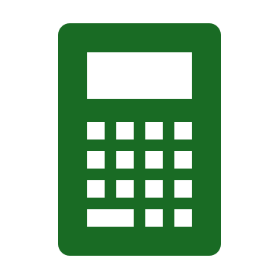
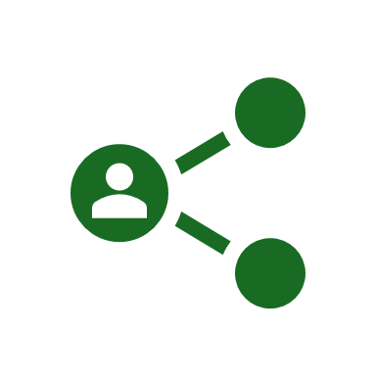
The Goal of Our Application
Our application was designed as a helpful nutrition aid and an introduction to weight and nutritional management.
The application offers multiple calculators for tracking calories, measuring BMI, and measuring BMR.
Additionally, the app offers helpful links and images to encourage further research into nutrition.

Slide 3



Technology Used
The user interface was designed using HTML alongside CSS, Bootstrap, and Google Fonts for styling.
The server, calculations, and routes were programmed in Python using the Flask API to run a test server.
The application is run using PyCharm, a JetBrains product, and the HTML portions of the project were written using VSCode before being connected to the PyCharm files.

Slide 4
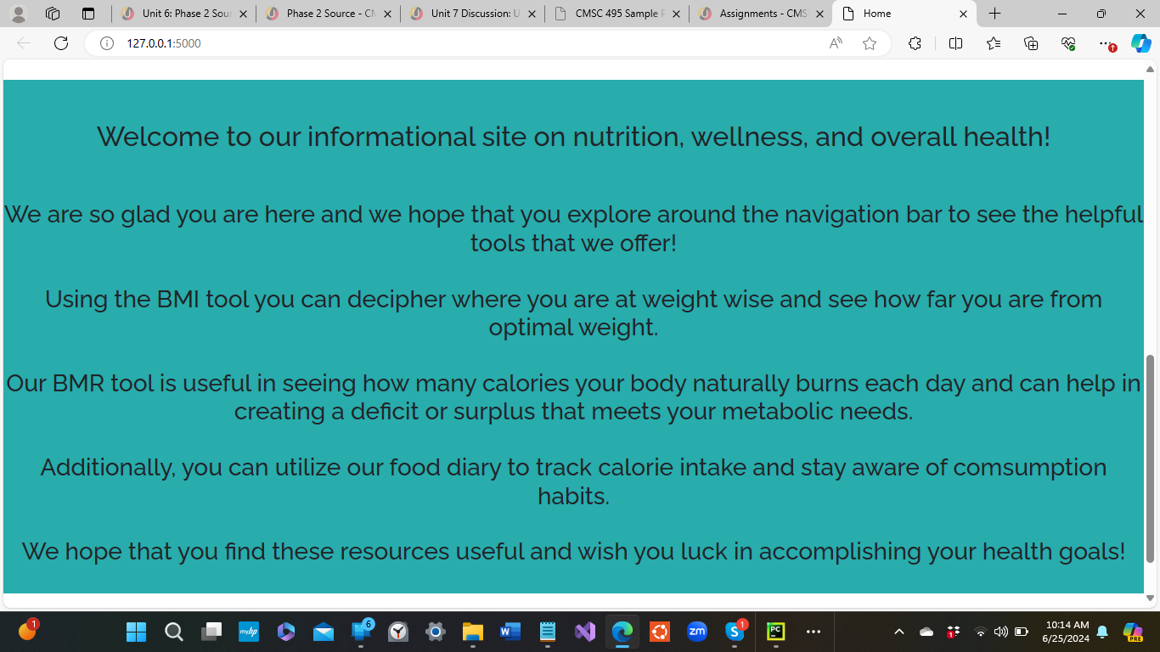
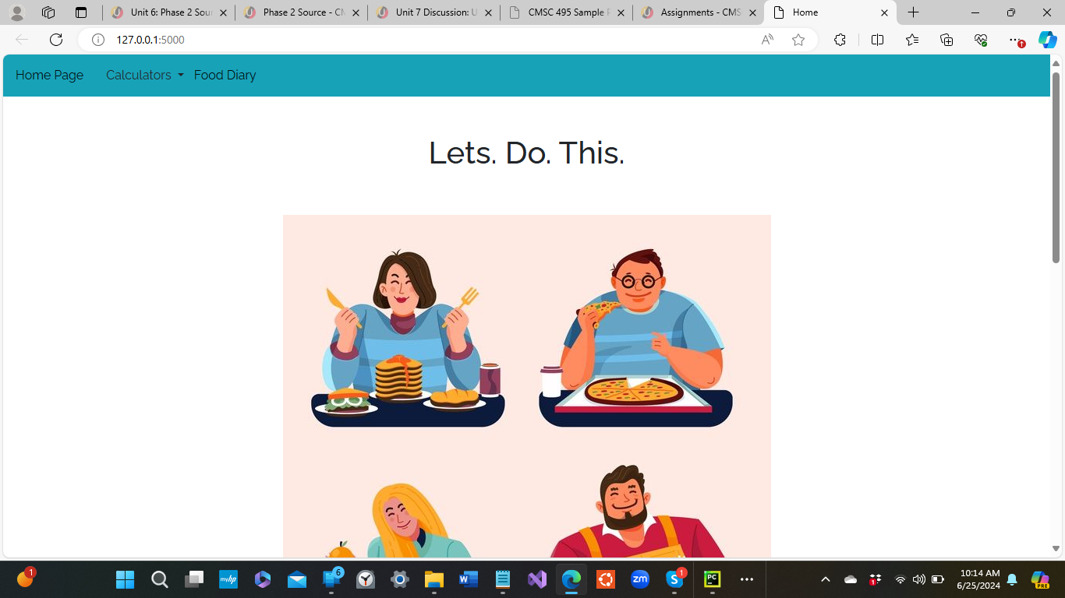
Home Page

Slide 5
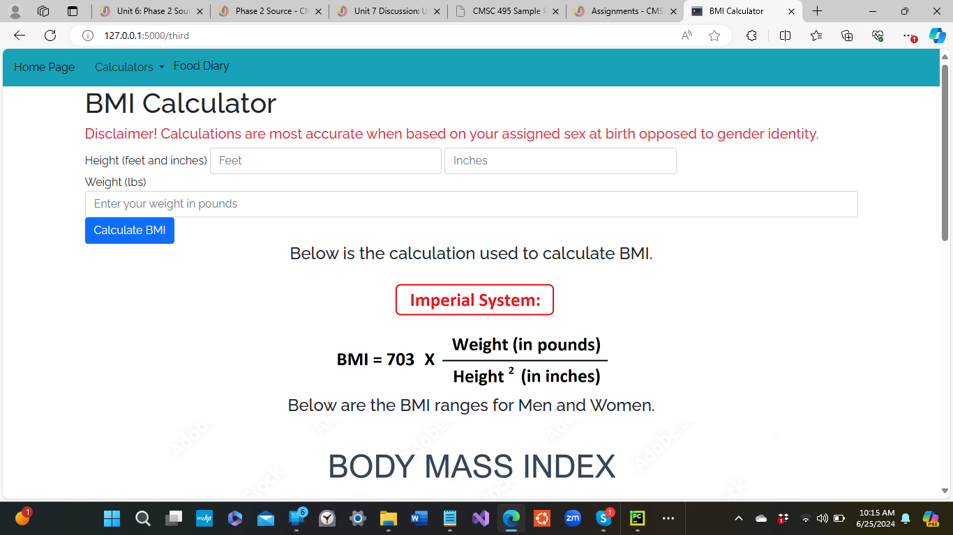
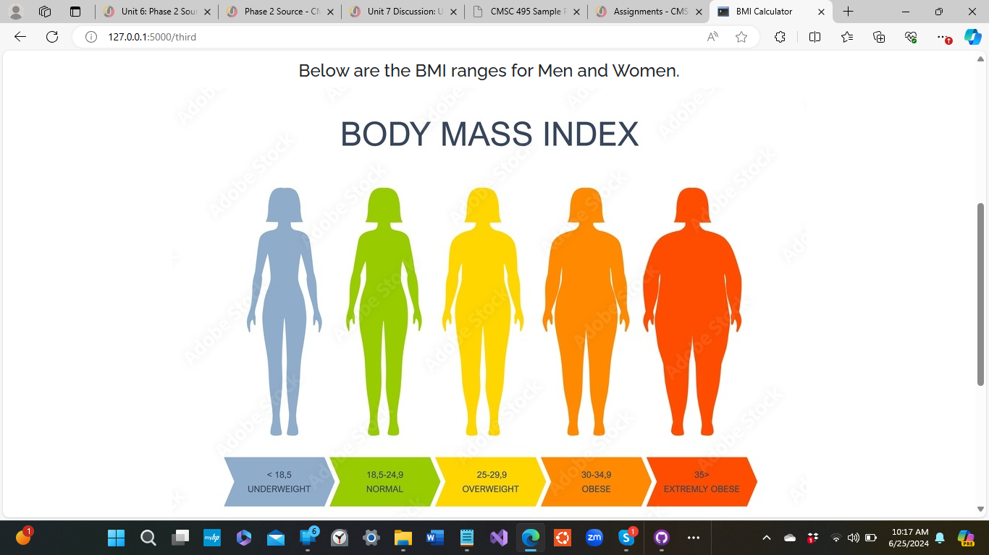
BMI Calculator

Slide 6
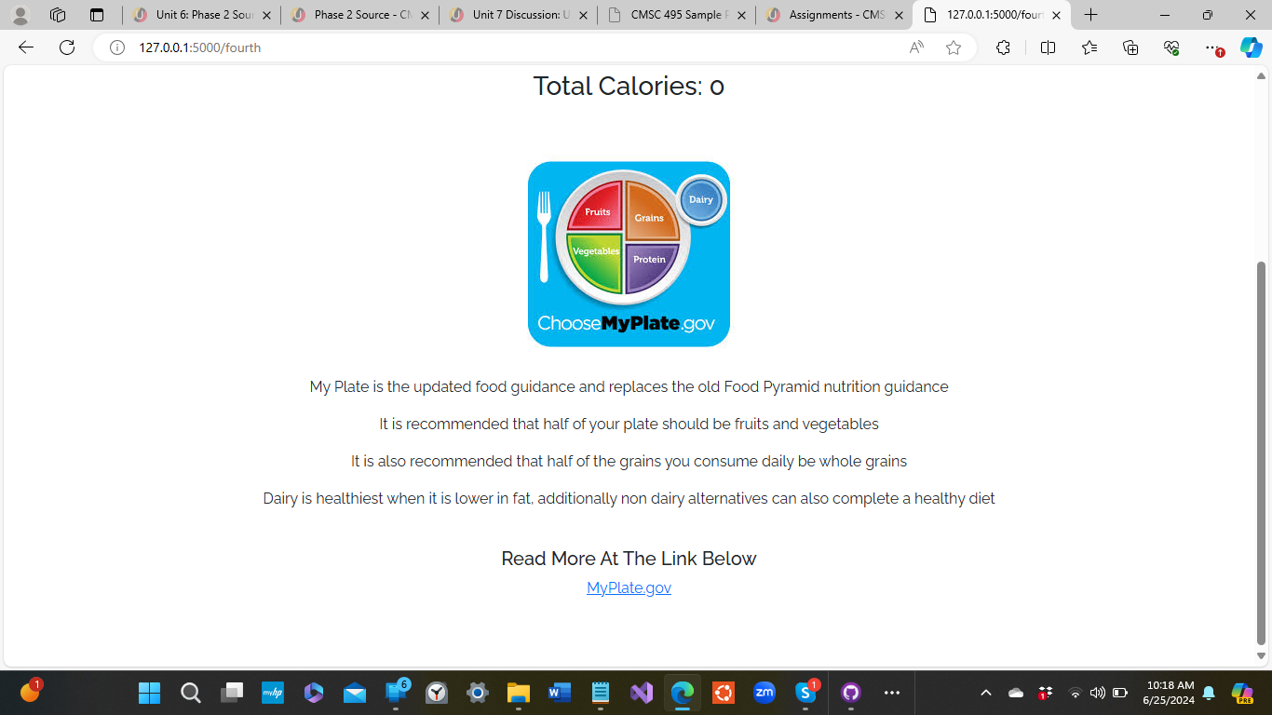
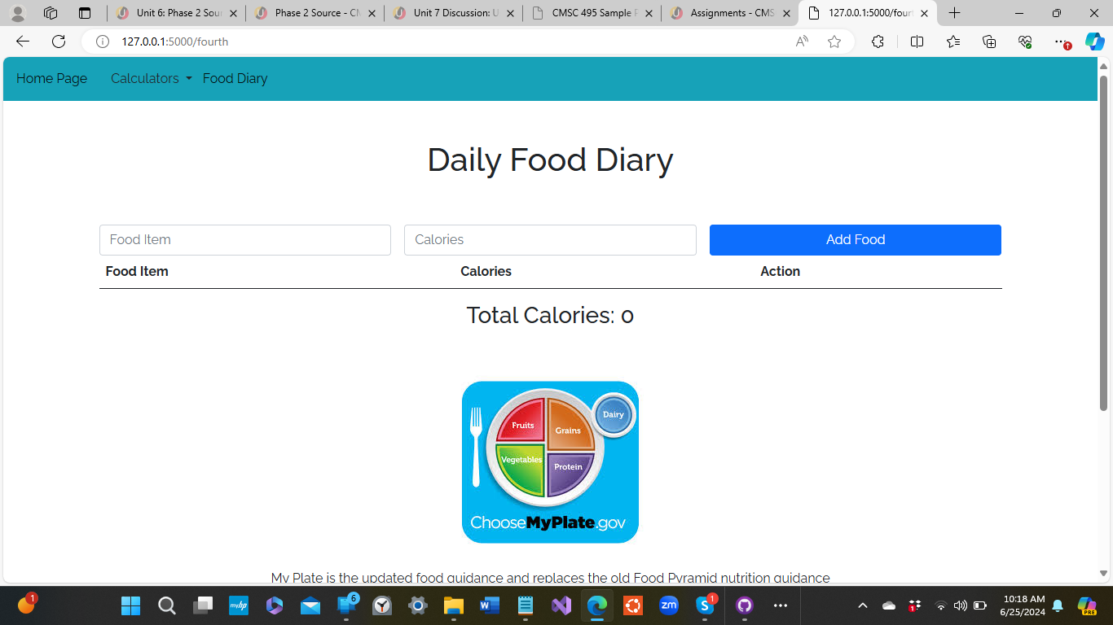
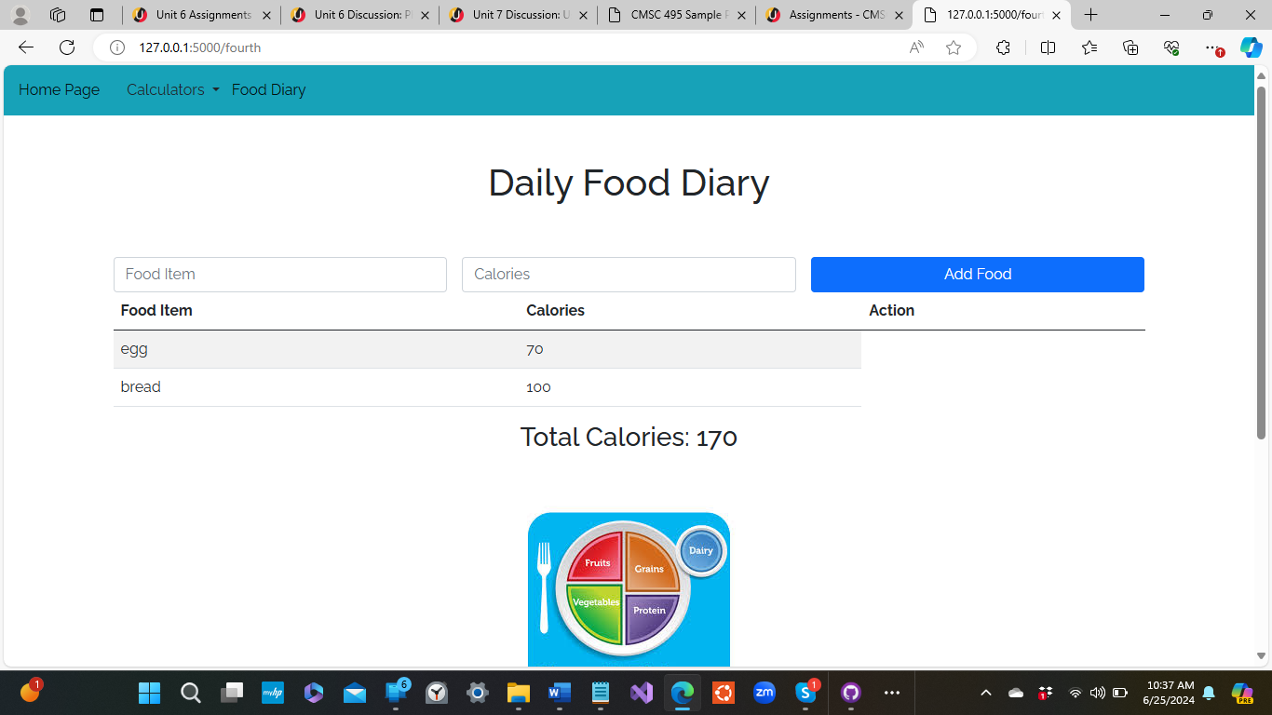
Food Diary

Slide 7
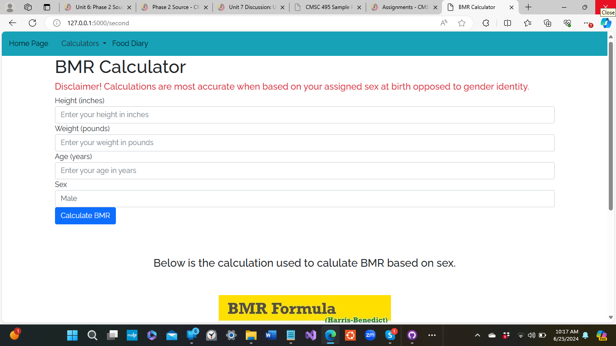
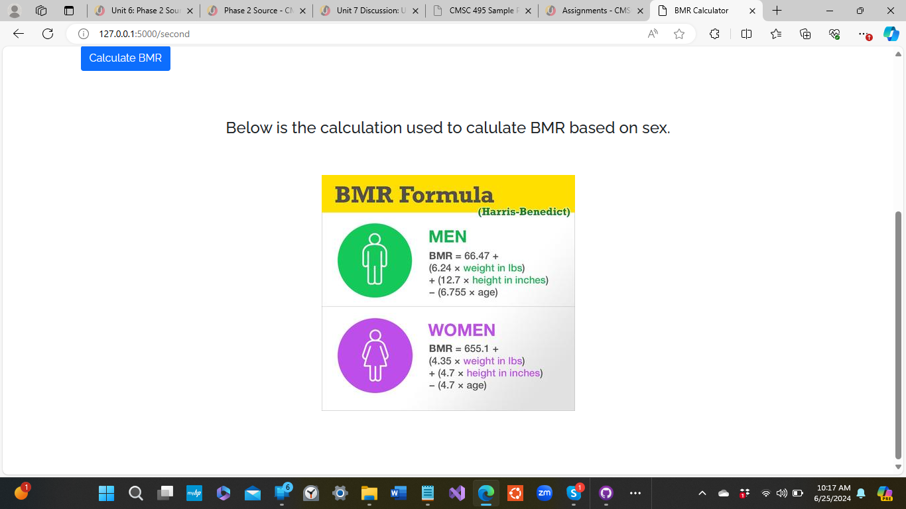
BMR Calculator

Slide 8
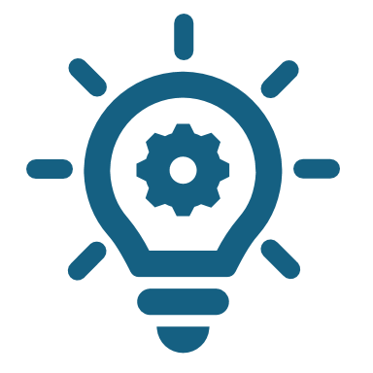
What Worked and What Didn't
From the beginning of this project as a group we knew that we wanted to create an application that was simple to use. We had agreed to stick to three functions that were designed and executed well rather than having many functions which weren't as well designed and thought out.
The most challenging part of this project was making the application as practical as possible. We wanted to create an application that was consumer focused and in doing so we had to take into account gender, the way we chose to do our calculations, and what resources we used to encourage further research.
Additionally there had been issues with connecting the user interface to the calculations using flask and it took lots of trial and error to ensure that the calculators worked and displayed as they were supposed to.

Slide 9

Thank You For Watching and Congratulations Class of 2024!!

